Slide 1

FACULTY OF SCIENCE AND ENGINEERING
ETHICS APPROVAL

Slide 2
When do you need to obtain ethics permission?
For any research which involves humans or vertebrate animals
e.g. anything involving questionnaires, interviews, monitoring human behaviours/activities or the use of data sets which contain information about humans.

Slide 3
When do you not need to obtain ethics permission?
Research which does not involve humans or vertebrate animals
e.g. surveying trees or litter distribution, monitoring air or water quality and testing soil or metal strength.
If you are in any doubt, please approach your supervisor or module convenor.

Slide 4
Why do you need to obtain ethics permission?
UNNC requires the highest standards of integrity to be followed in the pursuit of research carried out by the academic and research staff, and students of the University.
http://www.nottingham.edu.cn/en/research/ researchethics/unnc-research-code-of-conduct.aspx
http://workspace.nottingham.ac.uk/pages/viewpage.action?pageId=130353499

Slide 5
Failure to obtain ethics permission is considered to be research misconduct.
Students at The University of Nottingham have failed to graduate because they did not obtain ethics permission for their research in advance.
Please note that there will be random ethics checks each year by the Ethics Sub-Committee.

Slide 6
How do you apply for ethics permission?
This will depend on who you are and what you are trying to do...
ACTION: Complete CS Preliminary Research Ethics Checklist from the AE3IDS Moodle page and submit to supervisor.
If all answers “No”, no ethics approval required.

Slide 7
(1.1) Application process for UG, PGT and module conveners: UG & PGT students
If your research is for an internal class exercise, assignment, Bachelors or Masters dissertation or project then it can be approved by your module convenor or supervisor.
ACTION: Complete (1) ‘CS UG and PGT Research Ethics Checklist’ form, (2) ‘Participant Consent Form’, (3) ‘Participant Information Sheet’ and (4) any participant recruitment materials (eg, flyers, text of emails) and submit them to your module convener or supervisor (see next slide).

Slide 8
(1.2) Application process for UG, PGT and module conveners: Module Conveners & UG/PGT Supervisors
Permissions for individual UG or PGT students
(From previous slide) If a module convener or supervisor receives ethics application forms from individual UG or PGT students, they can approve the study themselves if it is ‘minimal risk’. If there is an ‘identified risk’, submit the forms to a Faculty Ethics Representative for assessment.
STAFF ACTION: If minimal risk, submit the ethics application forms to the Research Ethics Office for official registration (Joanna.HUANG@nottingham.edu.cn). If there is an identified risk, submit the forms to a Faculty Ethics Representative for assessment.

Slide 9
What happens after you submit your documents to a FoSE Ethics Representative?
Your application will be reviewed by two or more FoSE Ethics Representatives.
Applications will be classified as either
(1) Minimal Risk or (2) Identified Risk
Please note that if anything is unclear (e.g. you have not provided enough information to make an assessment) or if documents are missing, then the representatives will request that you re-write and re-submit your application.

Slide 10
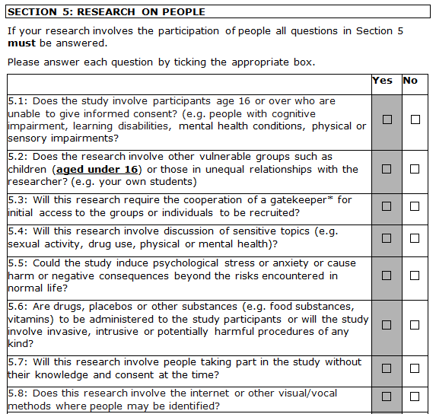
(1) Minimal risk applications
If there are no ethical issues with the application and no shaded boxes ticked in the application form (see right), the FoSE Ethics Panel may either:
(a) approve your application as a minimal risk study and send it to the Research Ethics Office for official registration (b) ask for minor revisions or clarifications before approval.
Examples of questions asked in the ‘Research Ethics Approval Form’ with shaded boxes indicating potential risk.

Slide 11
(2) Identified risk applications
If you have ticked any shaded boxes in the ethics application form and/or there are any ethical issues with your application, the FoSE Ethics Panel has three choices:
a) Approve
The FoSE Ethics Panel may decide your application can be approved as it stands without further revision.
b) Request application/study revision
The FoSE Ethics Panel may decide your application or study requires further clarification or revisions. In this situation, your application will be returned to you with advice on what needs to be revised.
c) Submit to full UNNC Research Ethics Sub-Committee

Slide 12
(2) Identified risk applications: Review by the full UNNC Research Ethics Sub-Committee
In some difficult cases, the FoSE Ethics Panel may decide that the application needs to be considered by the full UNNC Research Ethics Sub-Committee who will decide whether your application can be approved or requires further clarification or revisions.
The full UNNC Research Ethics Sub-Committee is made up of 22 people from all three faculties.

Slide 13
It can take several weeks for us to process your applications!
Please submit your applications as early as possible!
We cannot cope with last minute or incomplete ethics submissions and you cannot start your study until you have permission!

Slide 14
Ethics approval cannot be obtained retrospectively!

Slide 15
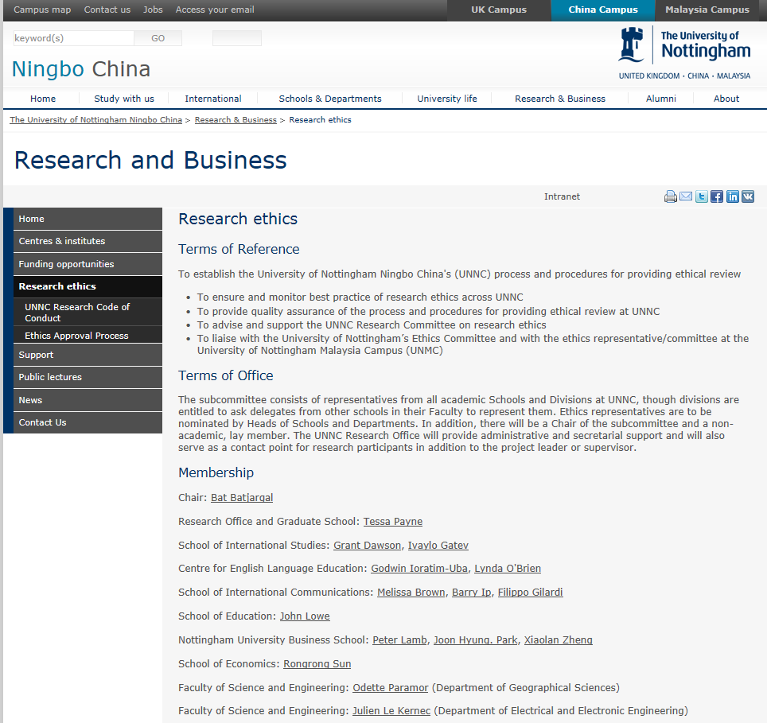
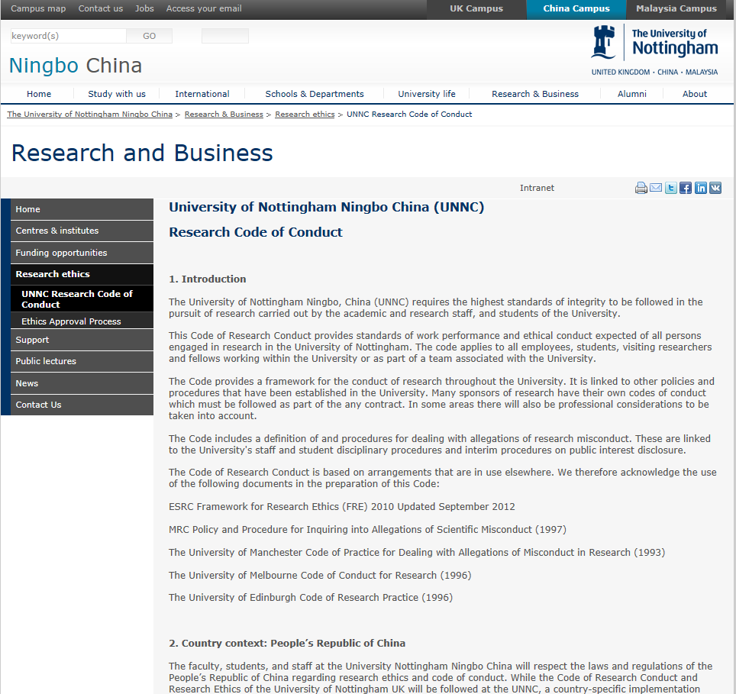
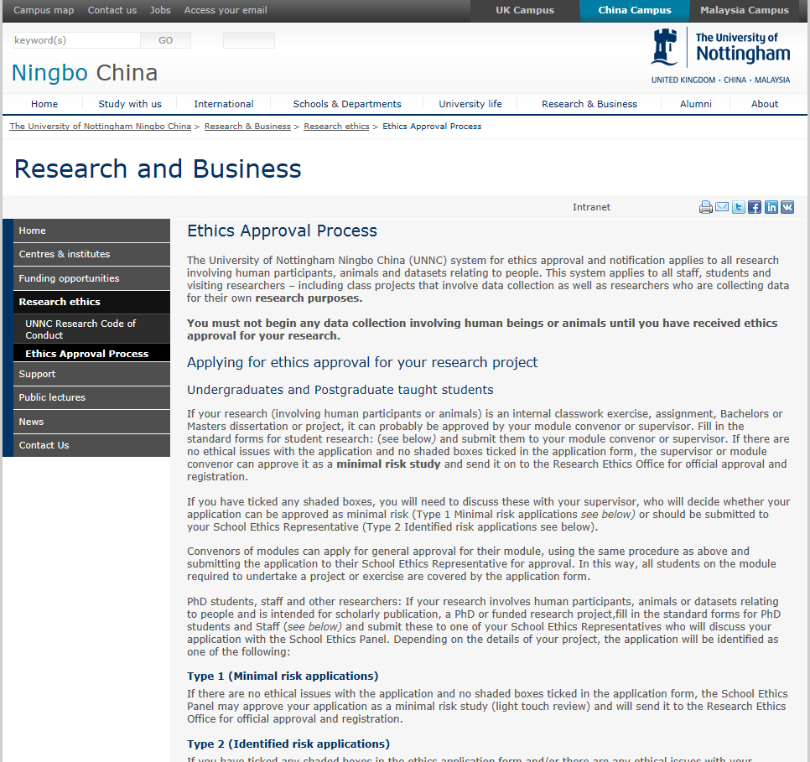
Where can you find the application forms and further information?
www.nottingham.edu.cn/en/research/
researchethics/researchethics.aspx

Slide 16
UG students & PGT students:
Submit to module convenor or supervisor
Summary for UG & PGT Students
Minimal risk application?
Yes
No
Module convenor or supervisor approves
Module convenor or supervisor discusses with students for revision
Module convenor or supervisor
sends the forms to the Research Ethics Office
Yes
Minimal risk revised application?
No
Module convenor or supervisor
sends it to the Faculty Ethics Reps

Slide 17
Common errors to avoid in your application...
Not providing enough information in the application form.
Reviewers need to know exactly what you intend to do. Do not be vague.

Slide 18
Common errors to avoid in your application...
Do not make an application without having fully planned your study.
e.g. approximate number of subjects to be interviewed, questionnaire design, obtaining permission to access field sites, duration of the interviews, justifying why and what you will video record and how you are going to process the data.
It is not our job to peer-review your experimental design or the experimental design of your students.

Slide 19
Application Advice
Your application will involve two or three documents:
A. Application Form
B. Participants’ Information Sheet
C. Participant’s Consent Form
- This is optional but you will need to justify why you are not using it and how you will obtain participants’ consent in the Application Form (Section 2)

Slide 20
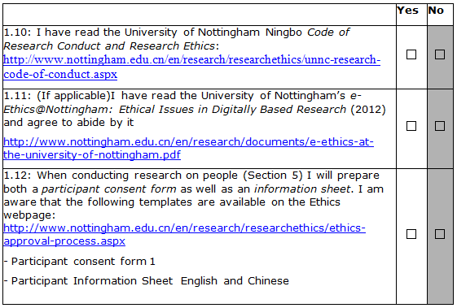
Application Advice
A. Application Form: Section 1
Will participants need to sign a consent form? If not, you will need to justify why you are not using it and how you will obtain participants’ consent in the Application Form (Section 2)

Slide 21
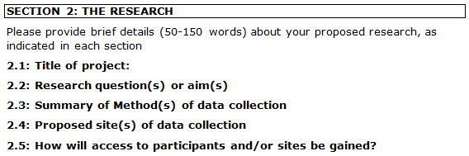
A. Application Form: Section 2
Pay particular attention to Sections 2.3 and 2.5 of the application form.
If you tick any of the shaded boxes in Sections 1, 3, 4 or 5 of the application form, you will need to explain how you intend to deal with any arising ethical issues in Section 2.

Slide 22
A. Application Form: Section 2.3
Questionnaires & Interviews
Include a copy of the questionnaire and a list of your main interview questions with your application.

Slide 23
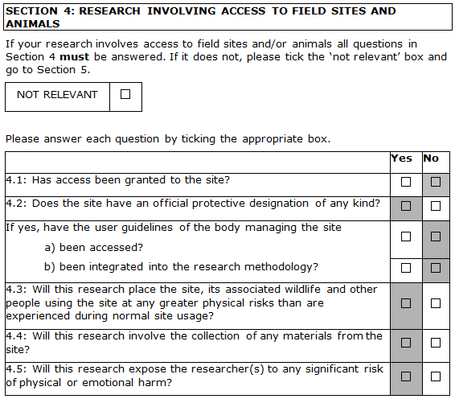
A. Application Form: Section 4
Field sites may include shopping centres, factories and office buildings! They are not just fields...
You will need to gain some kind of permission from the owners / managers if you are conducting research on their property.

Slide 24
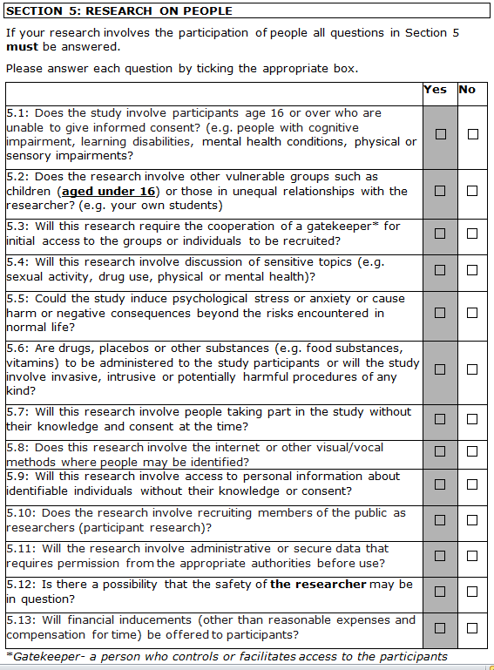
A. Application Form: Section 5
Unequal relationships
e.g. teacher – student
Gatekeeper: a person who controls or facilitates access to participants
Visual/Vocal Recording: What will you be video recording and why? Will you protect the participants’ anonymity?
Financial inducements?

Slide 25
B. Participants’ Information Sheet
Informed consent
Potential participants must fully understand what is it you are asking them to do and what the implications are for their involvement before they consent to being involved in your study.

Slide 26
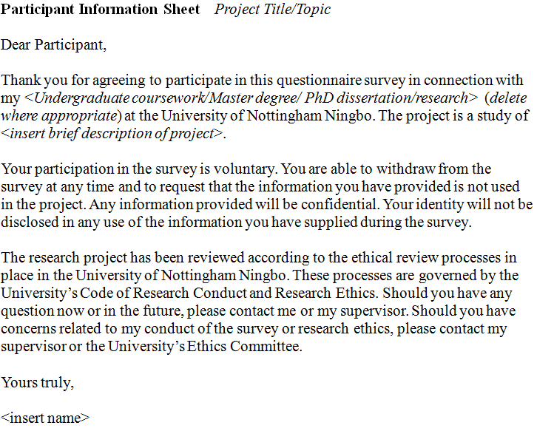
B. Participants’ Information Sheet
A draft of the participants’ information sheet is available on the Research Ethics website.
You MUST edit it.
Information should include (as a minimum): (1) an outline of your study, (2) what you expect participants to do and how long it will take them, (3) how you will store any data and (4) your contact details.

Slide 27
Please use clear, plain language for the Participants’ Information Sheet.
Do not use scientific/technical vocabulary unless your participants are specialists in the area and will understand the terminology and concepts.

Slide 28
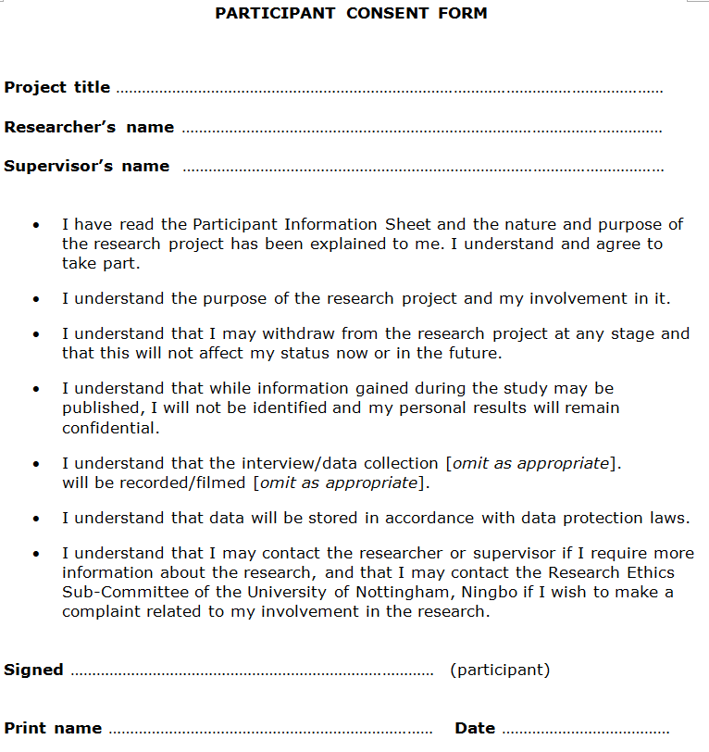
C. Participants’ Consent Form
This form is optional but you will need to justify why you are not using it and how you will obtain participants’ consent in the Application Form (Section 2)
Please edit as appropriate

Slide 29
Other issues to consider...
How are you going to gain access to your participants?
If you are using your students or your supervisor’s students as participants, you will need to make it clear that their involvement in your study will not affect their grades.

Slide 30
Other issues to consider...
Are you going to preserve the anonymity of participants? How are you going to achieve this?
You will need to describe this in the Participants’ Information Sheet and in Section 2.3 of the Application Form.
Also, take care when describing your study site when you publish, e.g. ‘Interviews were conducted at a Sino-foreign university in Zhejiang’.

Slide 31
Other issues to consider...
You will need to justify why you are making visual recordings. What will you be filming and why?
What specific data are you collecting that requires you to film participants? What part of their bodies are you going to be filming and why? If you say that you will preserve the anonymity of participants, how are you going to achieve this?

Slide 32
Other issues to consider...
How are you going to store the data?
You will need to describe the your data storage facilities and their security in the Participants’ Information Sheet.
How secure are your electronic devices? Can you make them more secure? Encryption? Temporary copies?

Slide 33
Any questions?
www.nottingham.edu.cn/en/research/
researchethics/researchethics.aspx

